Slide 1
Robotics
Michael Colistro
Unit 8 Activity 3 Emerging Technologies and Society

Slide 2
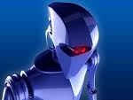
Bibliography
1.Types of Robots . The ROVer Ranch. 5 June 2010. http://prime.jsc.nasa.gov/ROV/types.html
John Rouda. Robots and their effect on society. 12 June 2006. 5 June 2010.
<http://www.johnrouda.com/classes/research/articles/Robots%20and%20their%20effect%20on%20society.pdf>

Slide 3
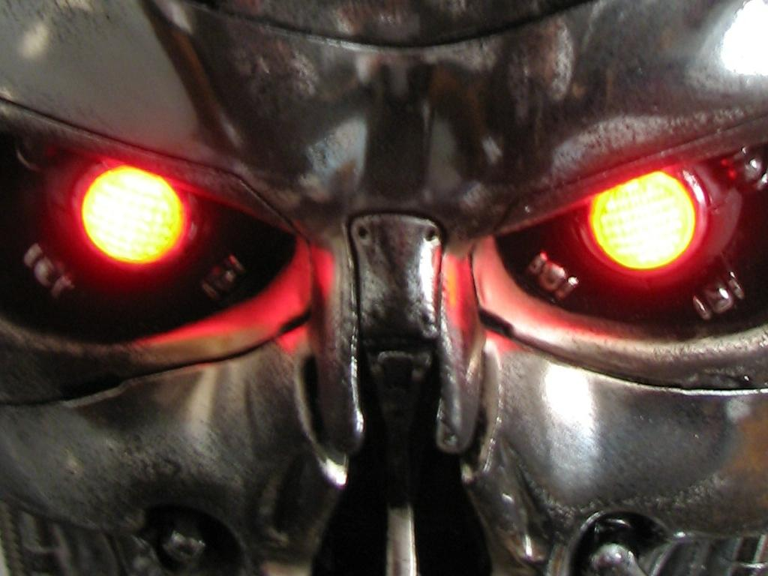
How and where robots are used.
Robots can be found in the manufacturing industry, the military, space exploration, transportation, and medical applications. Robots do jobs that are difficult, dangerous or dull. They lift heavy objects, paint, handle chemicals, and perform assembly work. They perform the same job hour after hour, day after day with precision. They don't get tired and they don't make errors associated with fatigue and so are ideally suited to performing repetitive tasks.

Slide 4
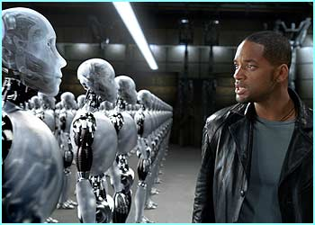
Robots and Society
Robots already have a huge impact in society today. One day we’ll have robots that go around our house, like Rosie, cleaning the floors, ironing our cloths, and cutting our grass. The technology is already here. Someday we may even have robots that are small enough to be injected in our bodies to help repair illness or injury and prevent dangerous surgeries.

Slide 5
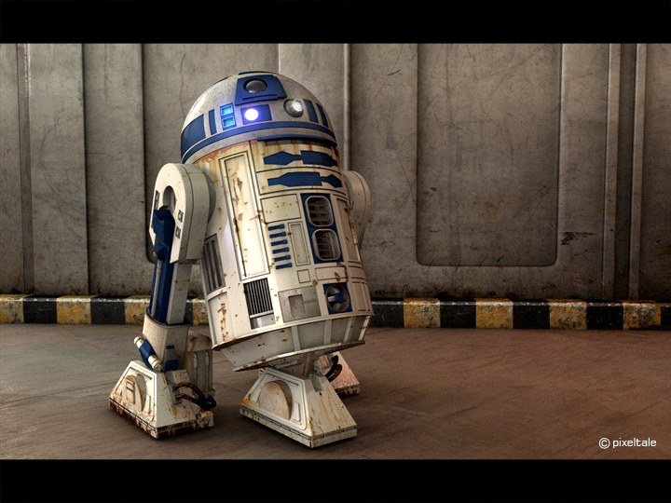
History of Robots
~270BC an ancient Greek engineer named Ctesibus made organs and water clocks with movable figures. in.
1965 - DENDRAL was the first expert system or program designed to execute the accumulated knowledge of subject experts.
1979 - The Standford Cart crossed a chair-filled room without human assistance. The cart had a tv camera mounted on a rail which took pictures from multiple angles and relayed them to a computer. The computer analyzed the distance between the cart and the obstacles.
1956 - George Devol and Joseph Engelberger formed the world's first robot company.
1970 - Shakey was introduced as the first mobile robot controlled by artificial intellence. It was produced by SRI International.
1959 - Computer-assisted manufacturing was demonstrated at the Servomechanisms Lab at MIT.
1961 - The first industrial robot was online in a General Motors automobile factory in New Jersey. It was called UNIMATE
.1963 - The first artificial robotic arm to be controlled by a computer was designed.

